Slide 1
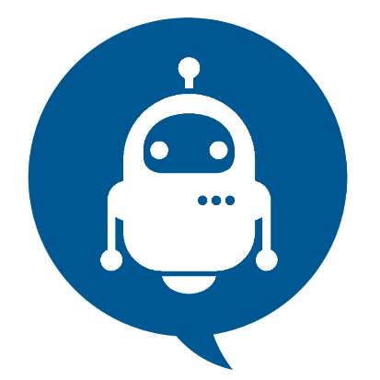
Chat bots
2
A computer program that can talk to humans in natural languagE
Notes:
2

Slide 2

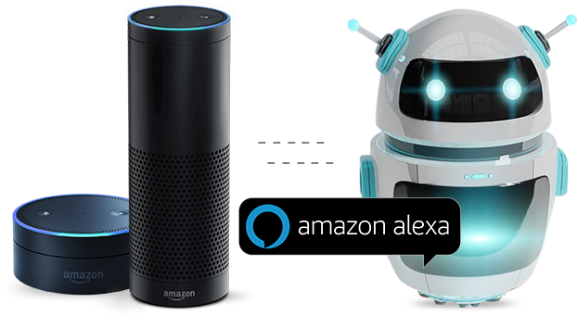
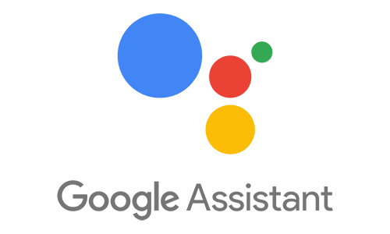
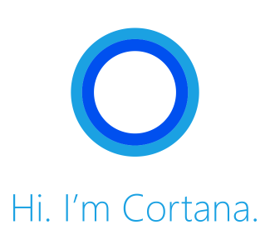

Examples
Hi, 👋 I’m NATASHA

Slide 3
2
Agenda
Introduction
Types of chatbots
History of chatbots
Working of chatbots
NLP
Advantages & Disadvantages
Building Alexa skill

Slide 4
2
Introduction
Chat Bot: A computer program that can talk to humans in natural language!
Uses Artificial Intelligence Markup Language (AIML) to represent knowledge.
Can replace a human for monotonous jobs of answering queries, e.g. E-help desk

Slide 5
2
Types Of Chat Bots
Rule-based chatbots
that can respond to specific commands.
Artificial intelligence chatbots
that respond to natural language.

Slide 6
2
How It All Started
Eliza – the first chat bot made by Joseph Weizenbaum in 1960.
Working of Eliza is based on
Knowledge Representation
Pattern Recognition
Substitution of key words into known phrases.

Slide 7
2
How it works?
A chatbot works in much the same way as a human manning a help desk. When a customer opens a chat dialogue to ask for assistance, the chatbot is the medium responding.

Slide 8
2
Natural Language Processing
Natural language processing (NLP) is the ability of a computer program to understand human speech as it is spoken. NLP is a component of artificial intelligence .
It makes computer to perform useful tasks with the natural languages humans use.
Current approaches to NLP are based on machine learning
The input and output of an NLP system can be −
Speech
Written Text

Slide 9
NLP has 3 specific concepts as follows
2
Entities:
This essentially represents an idea to your chatbot. For example, it may be a payment system in your E-commerce chatbot.

Slide 10
2
Natural Language Processing
Context:
When a natural language understanding algorithm examines a sentence, it doesn’t have the historical backdrop of the user’s text conversation. This implies that, if it gets a response to a question it has been recently asked, it won’t recall the inquiry. So, the phases during the conversation of chat are separately stored. It can either be banners like “Ordering Pizza”. Or could include other parameters like “Domino’s: Restaurant”. With context, you can easily relate expectations with the necessity of comprehending the last question.

Slide 11
2
Natural Language Processing
Expectations:
This is what a chatbot must fulfill when the customer says sends an inquiry. Which can be the same for different inquiries. For example, the goal triggered for, “I want to purchase a white pair of shoes”, and “Do you have white shoes? I want to purchase them” or “show me a white pair of shoes”, is the same: a list of shops selling white shoes. Hence, all user typing text show a single command which is the identifying tag; white shoes.

Slide 12
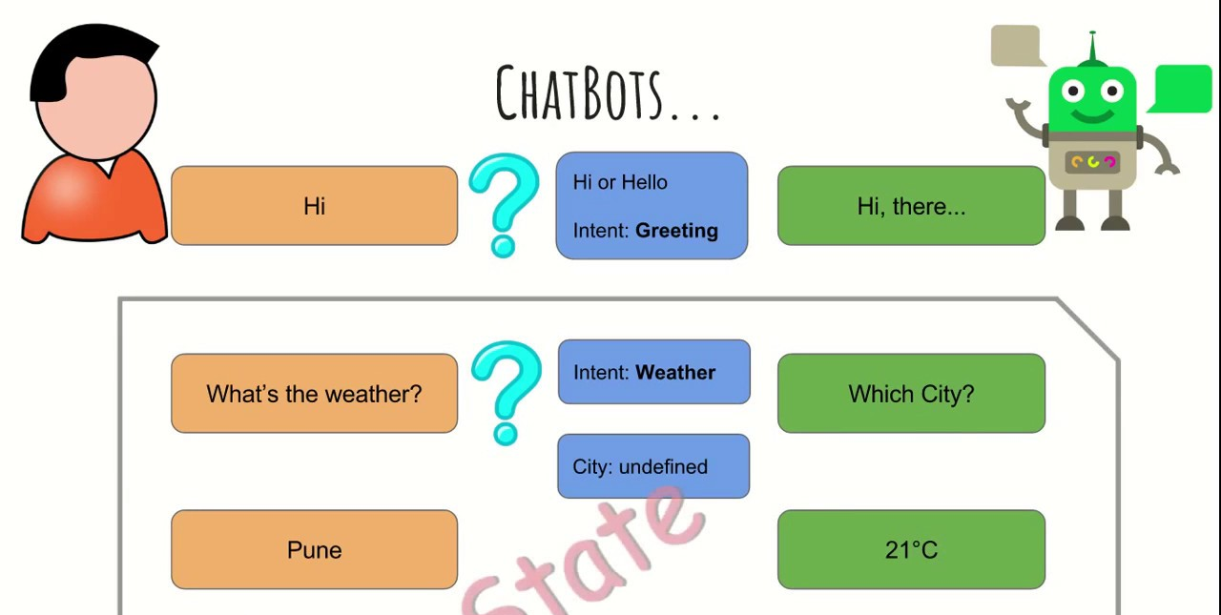
2
Working

Slide 13
2
How to create bot in Facebook messenger :
• First create the Facebook app at Facebook developer site.
• Select your page , you will get page access token that will be used later
For AI agent: • Api.ai • Bostify
These are the Natural Language Understanding platform.
Call back generated by any of them , will have to submit to our Facebook app and your bot is ready .
To make your Messenger bot public, submit your app for approval in the 'App Review for Messenger' section on the Messenger page of your Facebook app.

Slide 14
2
Advantages To Use Of Chatbots
Keeping Up with the Trends: Being Present on Messaging Platforms2.
Improved Customer Service
Increased Customer Engagement
Monitoring Consumer Data & Gaining Insights
Better Lead Generation, Qualification and Nurturing
Easier Approach to Global Markets
Cost Savings

Slide 15
2
Conclusion
The best conversations are the ones where a lot is yet to be said. Chatbots are at that stage of their journey right now.

Slide 16
2
Thank You !

